Slide 1
Biol 7200: Programming for Bioinformatics Introduction to python

Slide 2
Plan for today
Python
Jupyter notebooks (handouts)
Demo

Slide 3
Plan for today
Python
Jupyter notebooks (handouts)
Demo

Slide 4
Python topics
Why not just use Bash or another language?
Python specifics for this course
Some Python types: int, float, str, list, dict

Slide 5
Python topics
Why not just use Bash or another language?
Python specifics for this course
Some Python types: int, float, str, list, dict

Slide 6
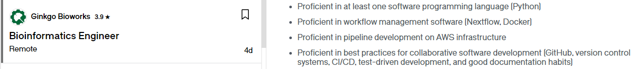
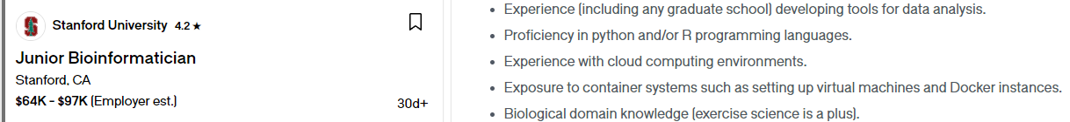
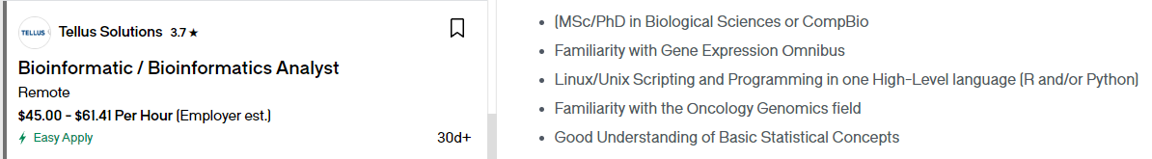
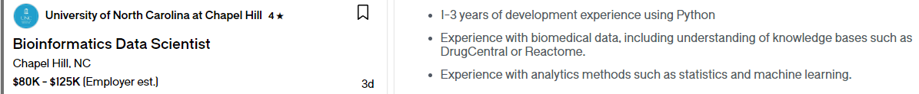
Python is what employers want

Slide 7
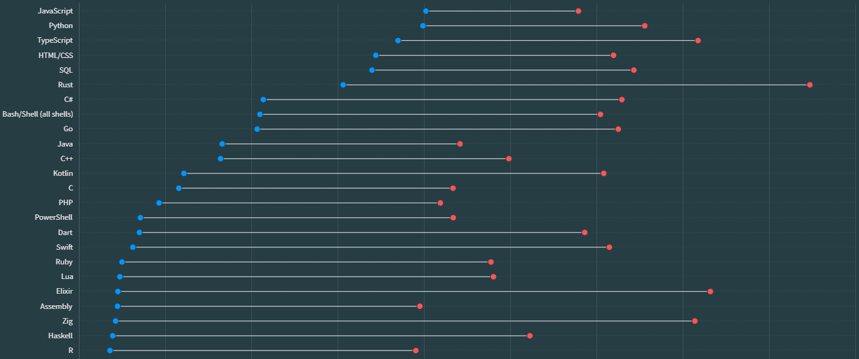
Python is 2nd most used language and is popular
https://survey.stackoverflow.co/2023/#section-admired-and-desired-programming-scripting-and-markup-languages

Slide 8
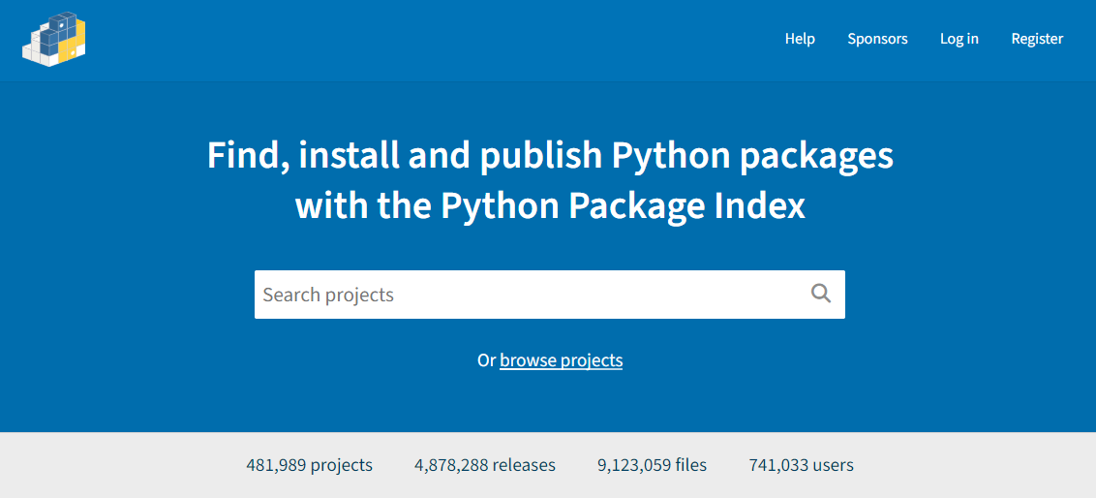
Python has a huge array of packages

Slide 9
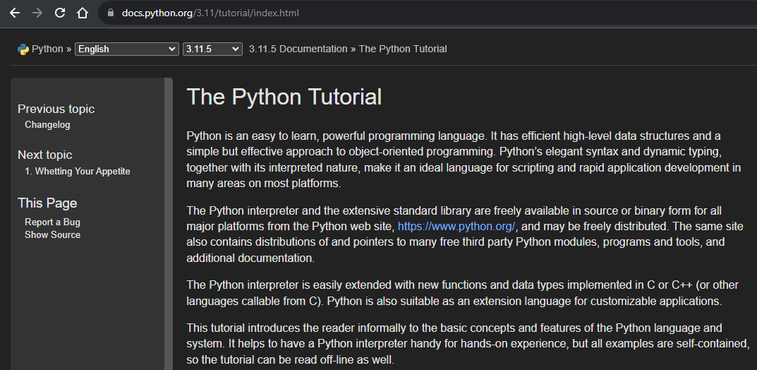
Python has excellent documentation
https://docs.python.org/3.11/tutorial/index.html

Slide 10
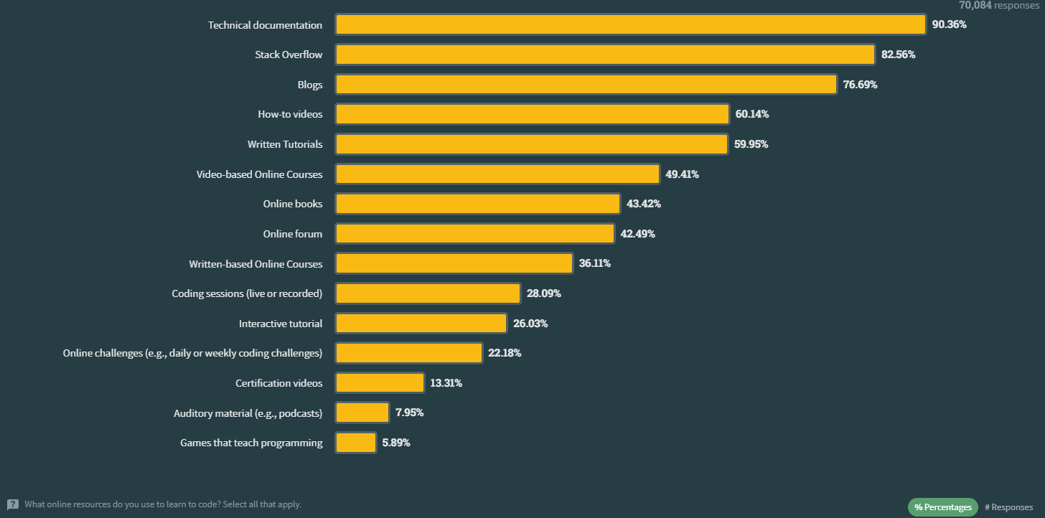
documentation is an important learning resource
https://survey.stackoverflow.co/2023/#section-learning-to-code-online-resources-to-learn-how-to-code

Slide 11
Python topics
Why not just use Bash or another language?
Python specifics for this course
Some Python types: int, float, str, list, dict

Slide 12
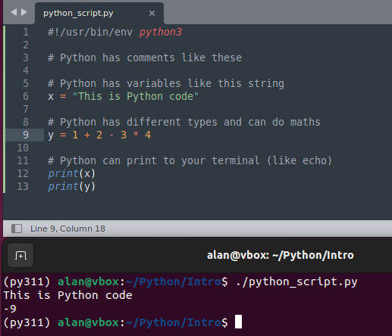
Python is a scripting (interpreted) language
Like Bash, Python code is simply words
A program on your computer reads the words and interprets them
The words and syntax differ from bash, but the idea is the same

Slide 13
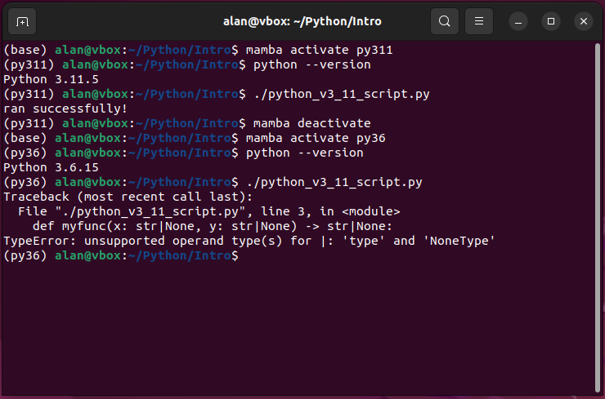
Newer versions of python have extra features
Python is being constantly developed and improved
Python 3.11 is the current version (v3.12 due October 2nd)
Demonstrated code will use Python 3.11 features
Best to learn the latest version

Slide 14
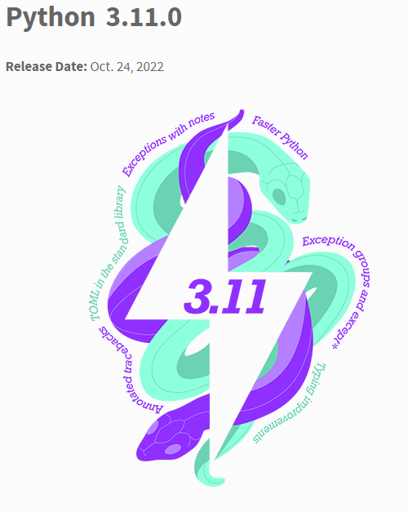
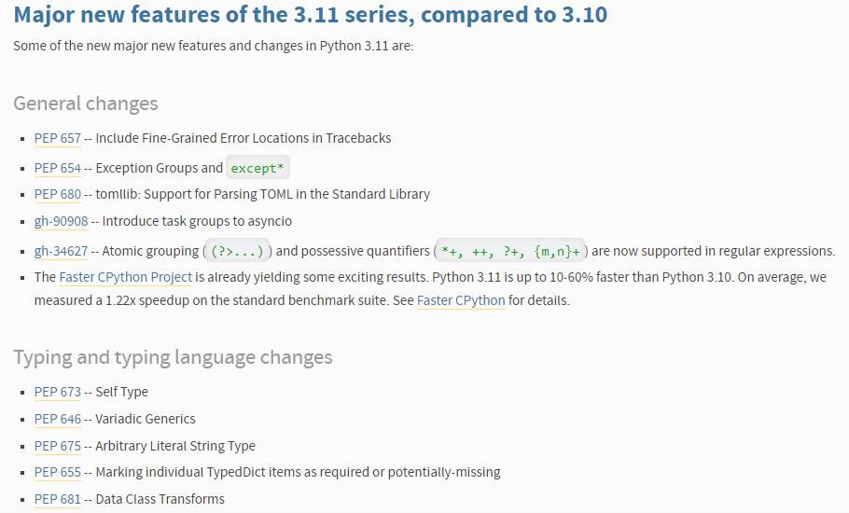
Each new Python version includes improvements

Slide 15
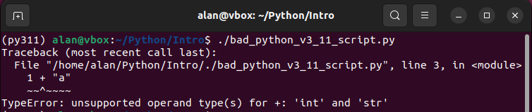
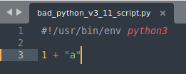
Python 3.11 has helpful error messages
When something is wrong with your Python code, the interpreter throws an error:
A traceback stating in which module and which line the problem occurred
The kind of error that occurred (TypeError, ValueError etc.)
New in 3.11: where in the line the mistake is

Slide 16
Python topics
Why not just use Bash or another language?
Python specifics for this course
Some Python types: int, float, str, list, dict

Slide 17
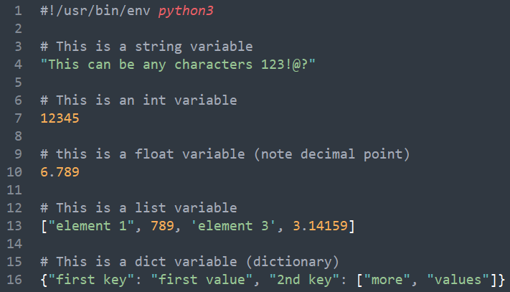
Python has several built-in types (A.K.A classes)
Strings (str) contains text and other characters
Integers (int) are a whole numbers
Floating point numbers (float) are numbers with decimal places
Lists (list) are arrays of any variable type
Dictionaries (dict) are pairs of associated data (keys and values)

Slide 18
Python classes have different methods
Each class has an associated set of things that they can do
The things that each class can do are determined by its “methods”
Methods are named functions that are defined for a class (more on this later)
It is the difference in behavior of each class that distinguishes them

Slide 19
Any class can be assigned to a variable
Python variable assignment works the same as Bash: variable = data
Note that white space around the assignment operator (=) is tolerated
In Python, whitespace is interpreted differently from in Bash.
Only indentation is enforced
Many of the rules governing whitespace in Python are style guidelines not syntax rules (more on this later)

Slide 20
Plan for today
Python
Jupyter notebooks (handouts)
Demo

Slide 21
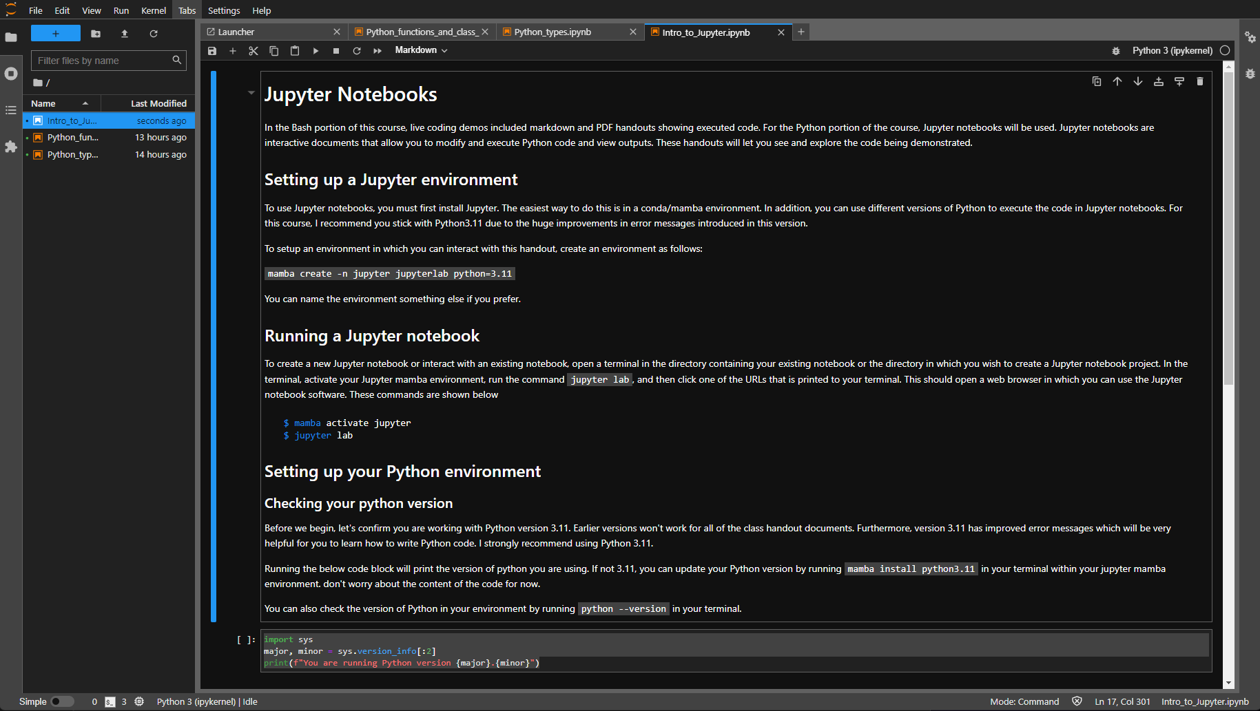
Coding handouts will use jupyter notebooks

Slide 22
Plan for today
Python
Jupyter notebooks (handouts)
Demo

Slide 23
To the demo

